Slide 1
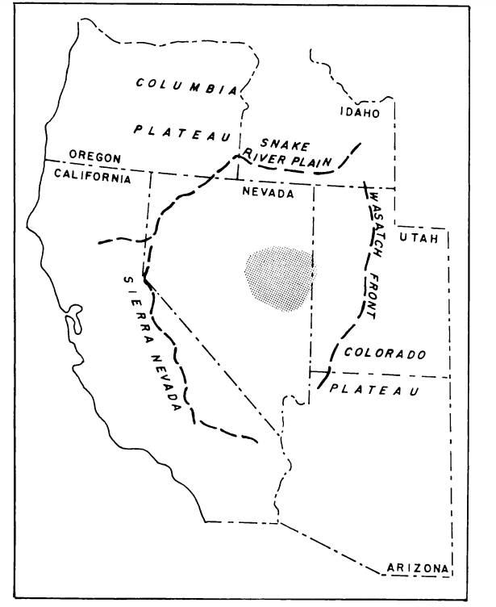
Distribution of Silicic Volcanism in the Great Basin
Armstrong et. al. 1969
Ryan Parkyn

Slide 2
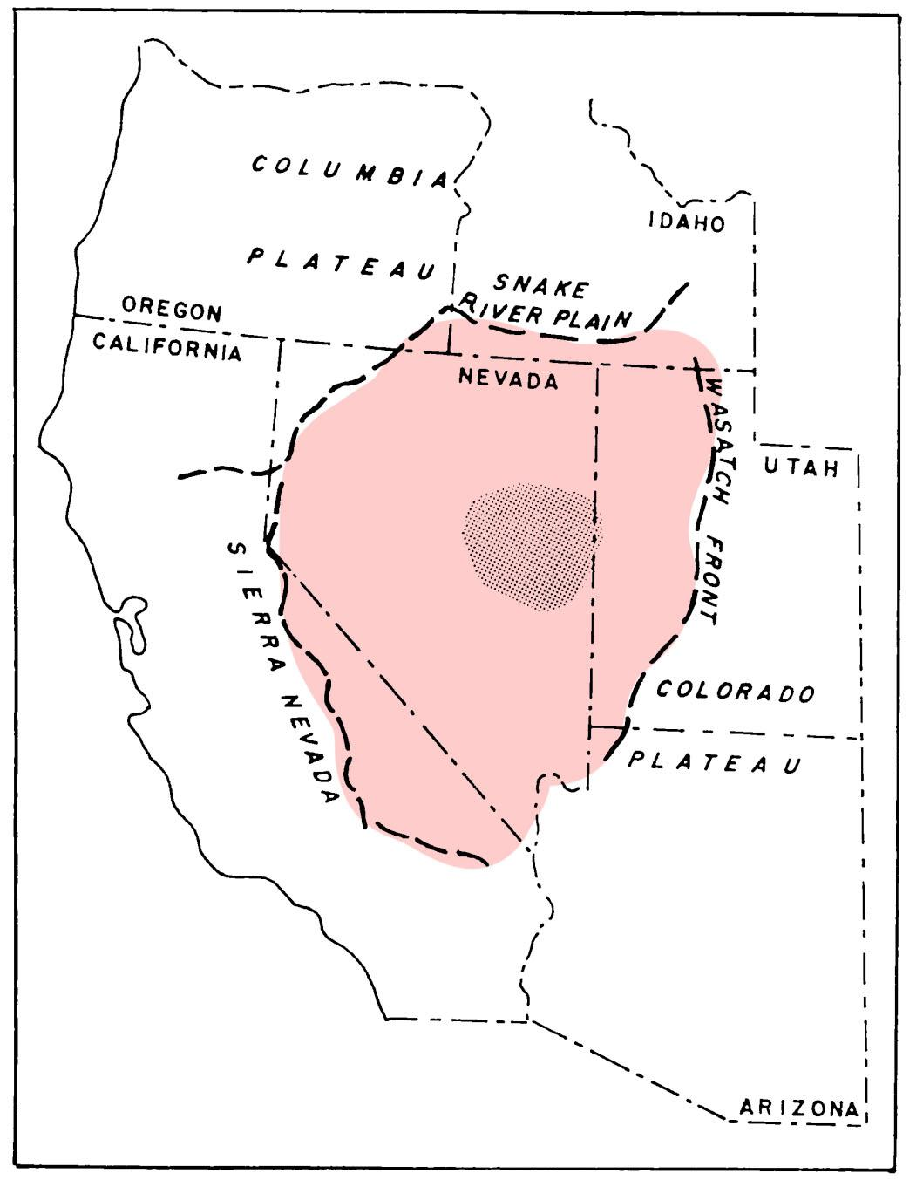
Distribution of Cenozoic volcanics
Study area great basin = east-central nevada and locally other regions
n=250 K-Ar ages of siliceous volcanics from literature
Biotite and sanidine
Extends to geomorphological boundaries of GB

Slide 3
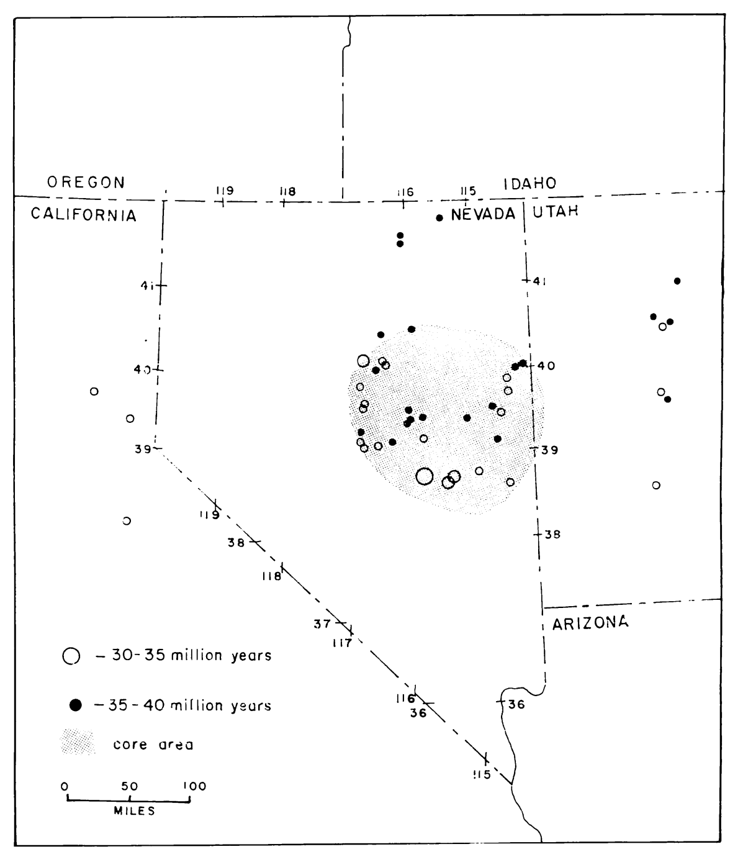
Distribution of Cenozoic volcanics
Oldest silicic volcanics constrained to east central nevada
30-35Ma
35-40Ma

Slide 4
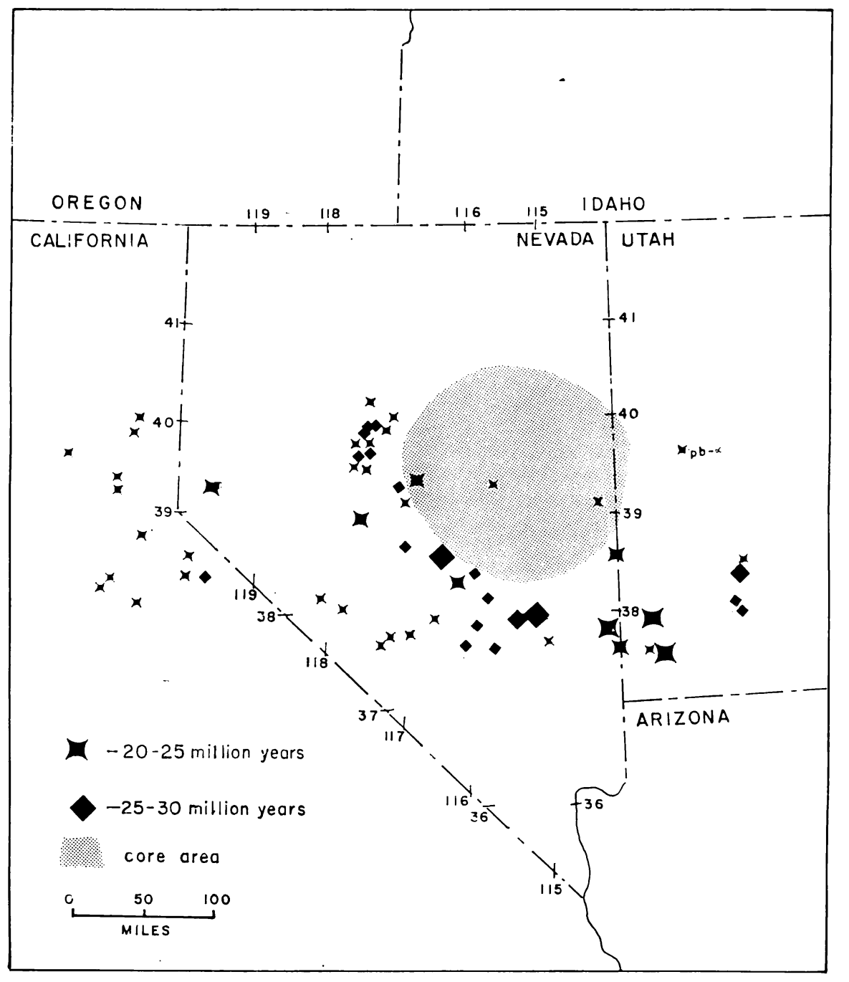
Distribution of Cenozoic volcanics
Silicic volcanics aged 20-25 Ma and 25-30 Ma lies outside east-central Nevada (“Intermediate”)
Outliers: Volcanics near Wasatch Front

Slide 5
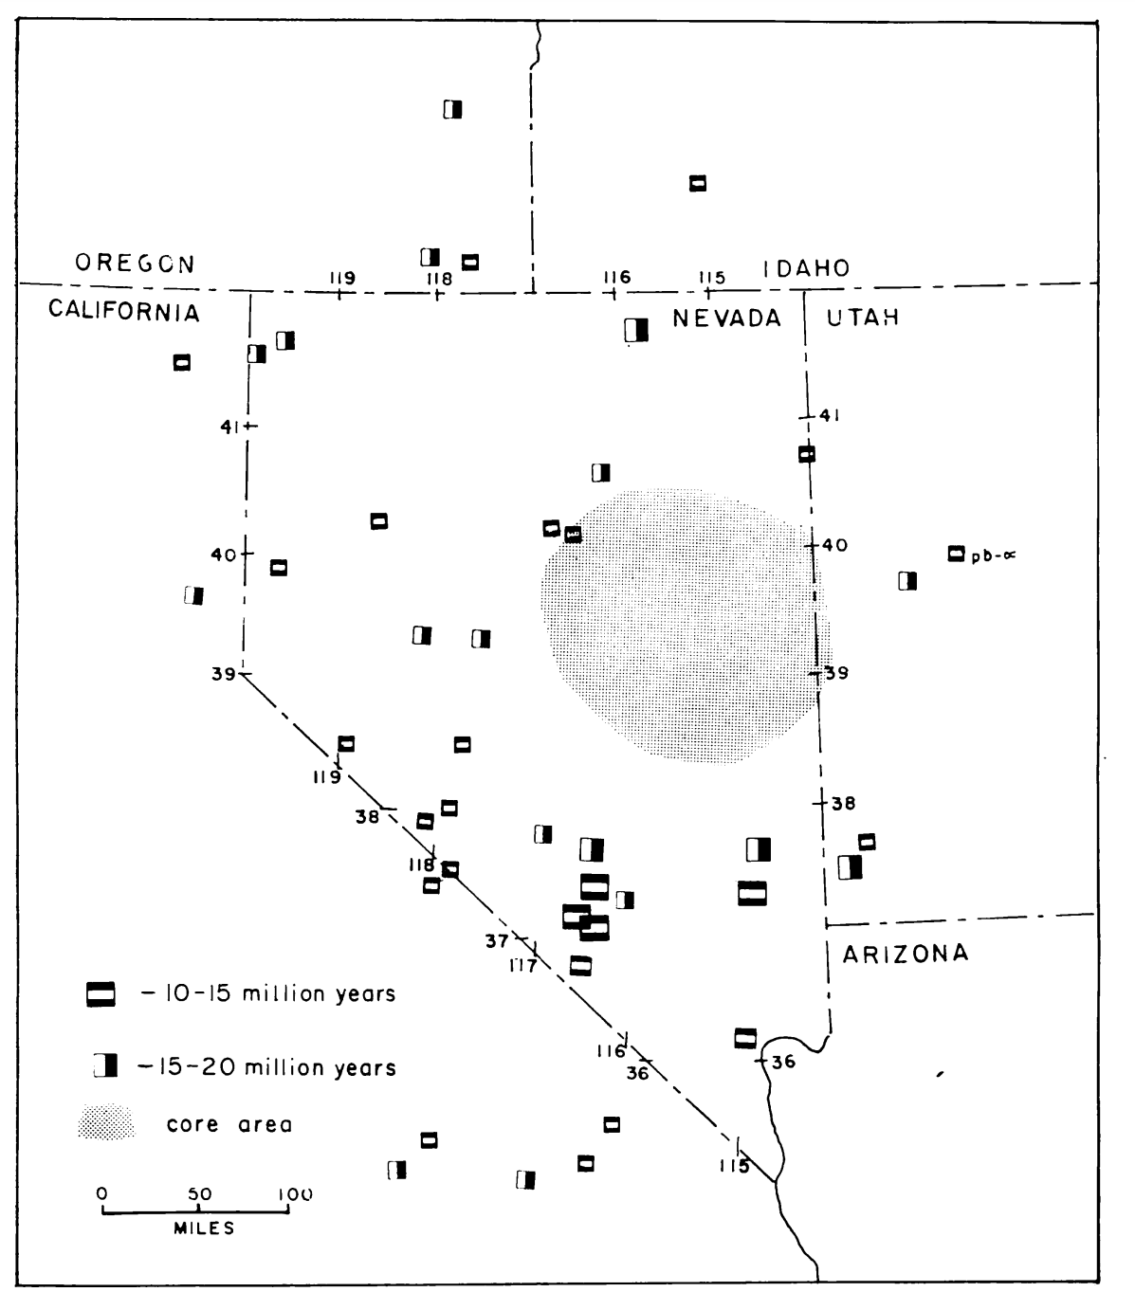
Distribution of Cenozoic volcanics
Younger 10-15Ma and 15-20Ma volcanics lie in margins of Great Basin

Slide 6
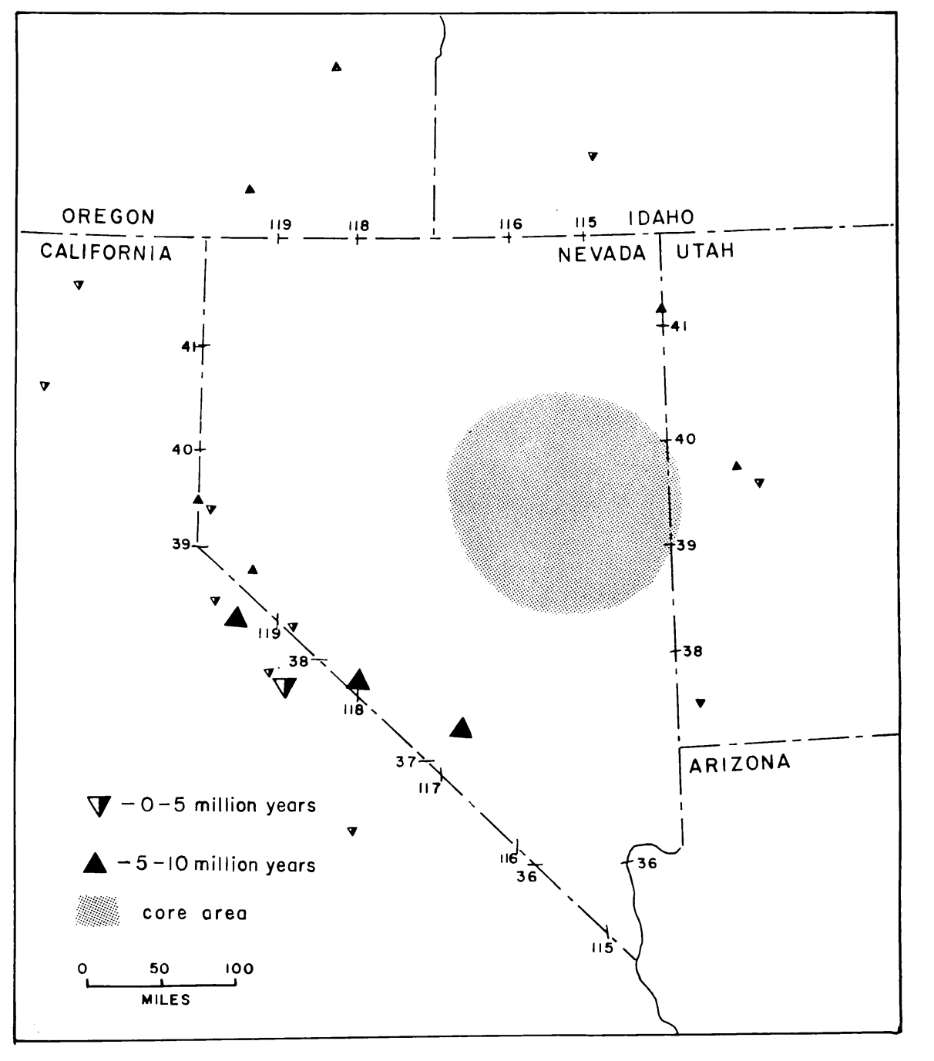
Distribution of Cenozoic volcanics
Youngest 5-10 M and 0-5Ma volcanics are less abundant and are at furthest extent of Great Basin

Slide 7
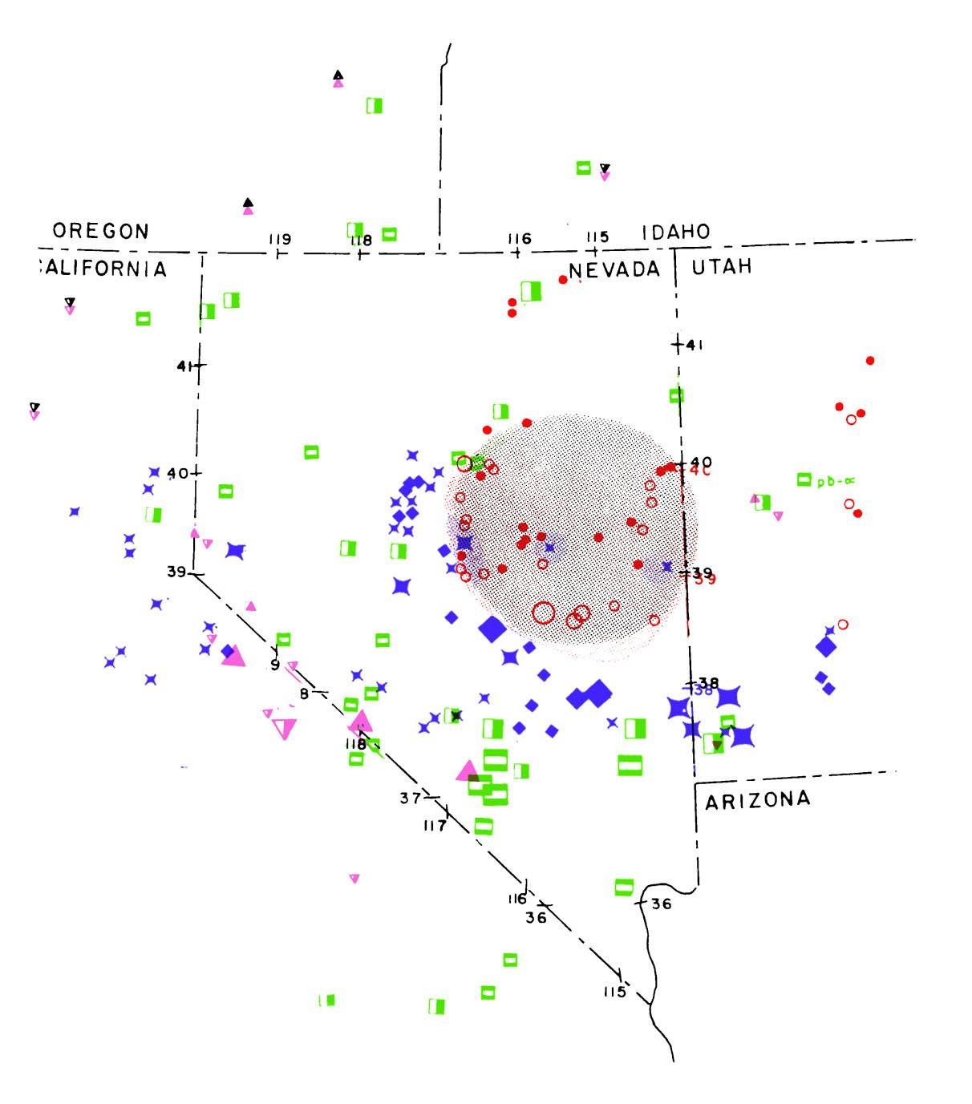
Red = 30-40Ma
Blue = 30-20Ma
Green = 20-10 Ma
Pink = 10 - 0 Ma

Slide 8
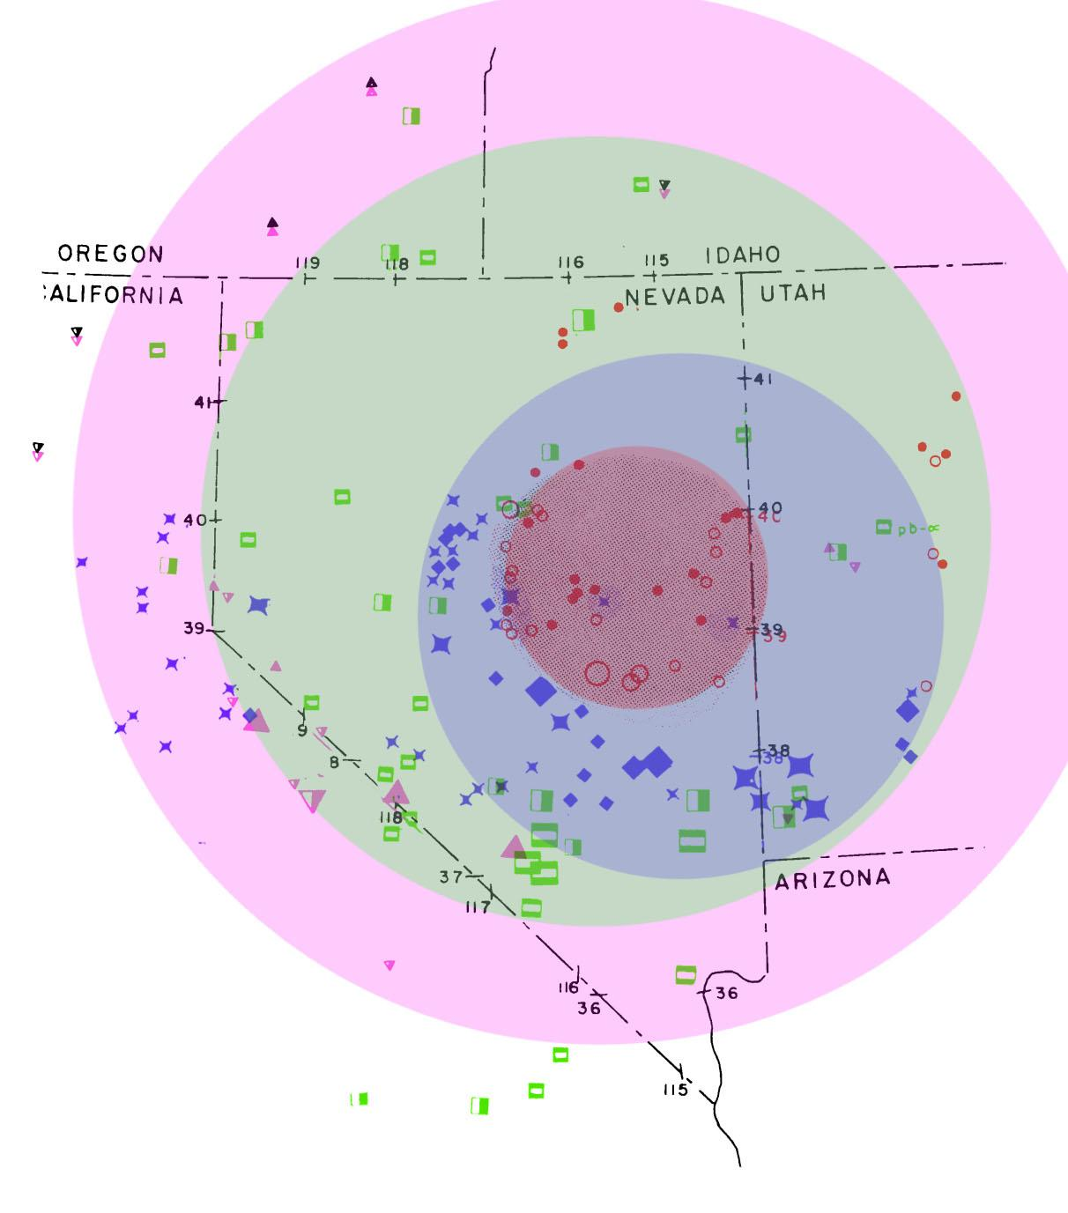
Red = 30-40Ma
Blue = 30-20Ma
Green = 20-10 Ma
Pink = 10 - 0 Ma
Hypothesis 1:
Extension beneath continent of the east pacific rise
Hypothesis 2:
Magma generation from direct heating of lower crust
Hypothesis 3:
Convection current of mantle led to magma diapirs. Distention and fractures led to decompression melting
Volcanics distribution consistent with other features such as:
Large scale normal faulting
Crustal thickening/thinning
Seismic velocities/densities
Heat flow

Slide 9
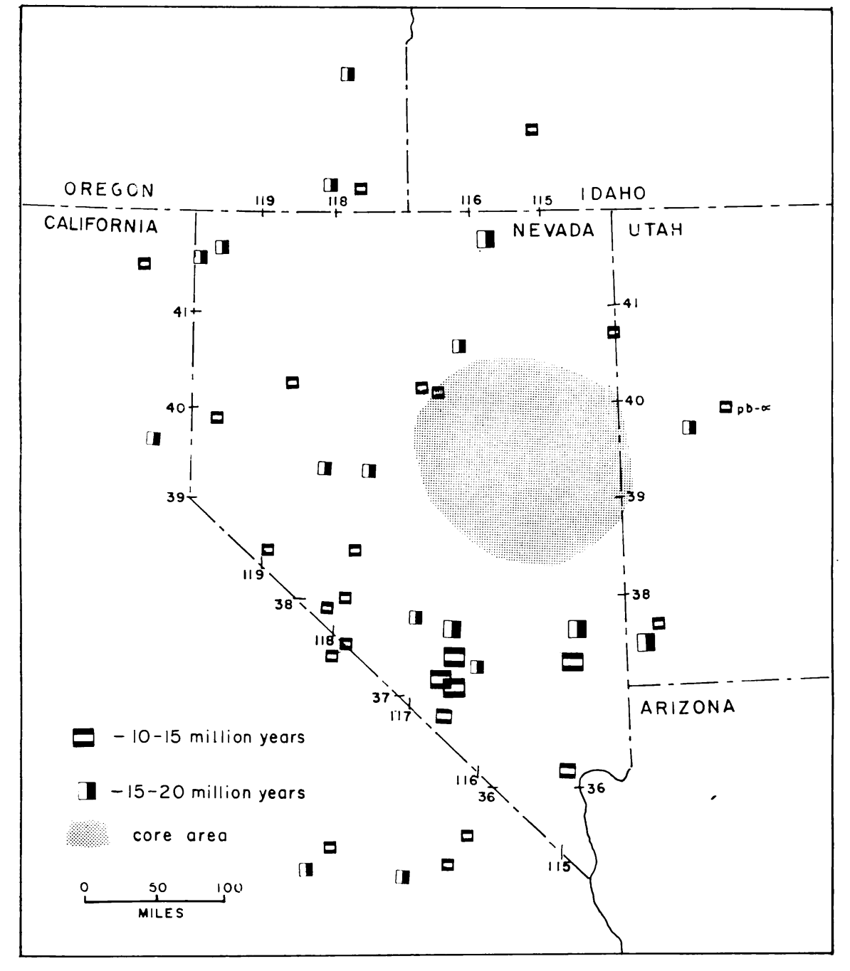
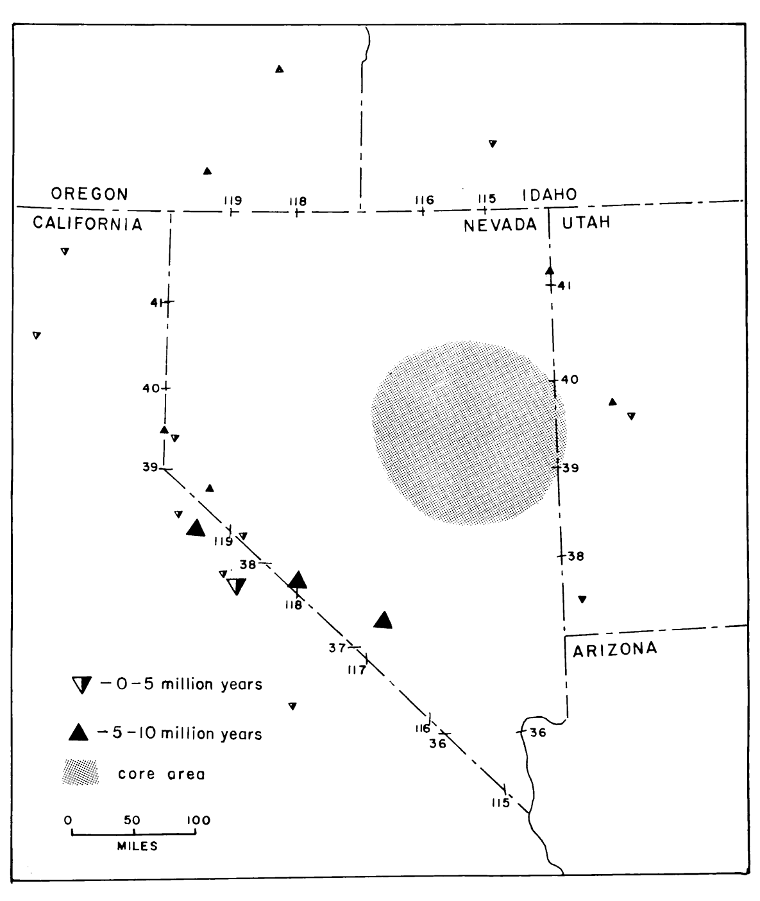
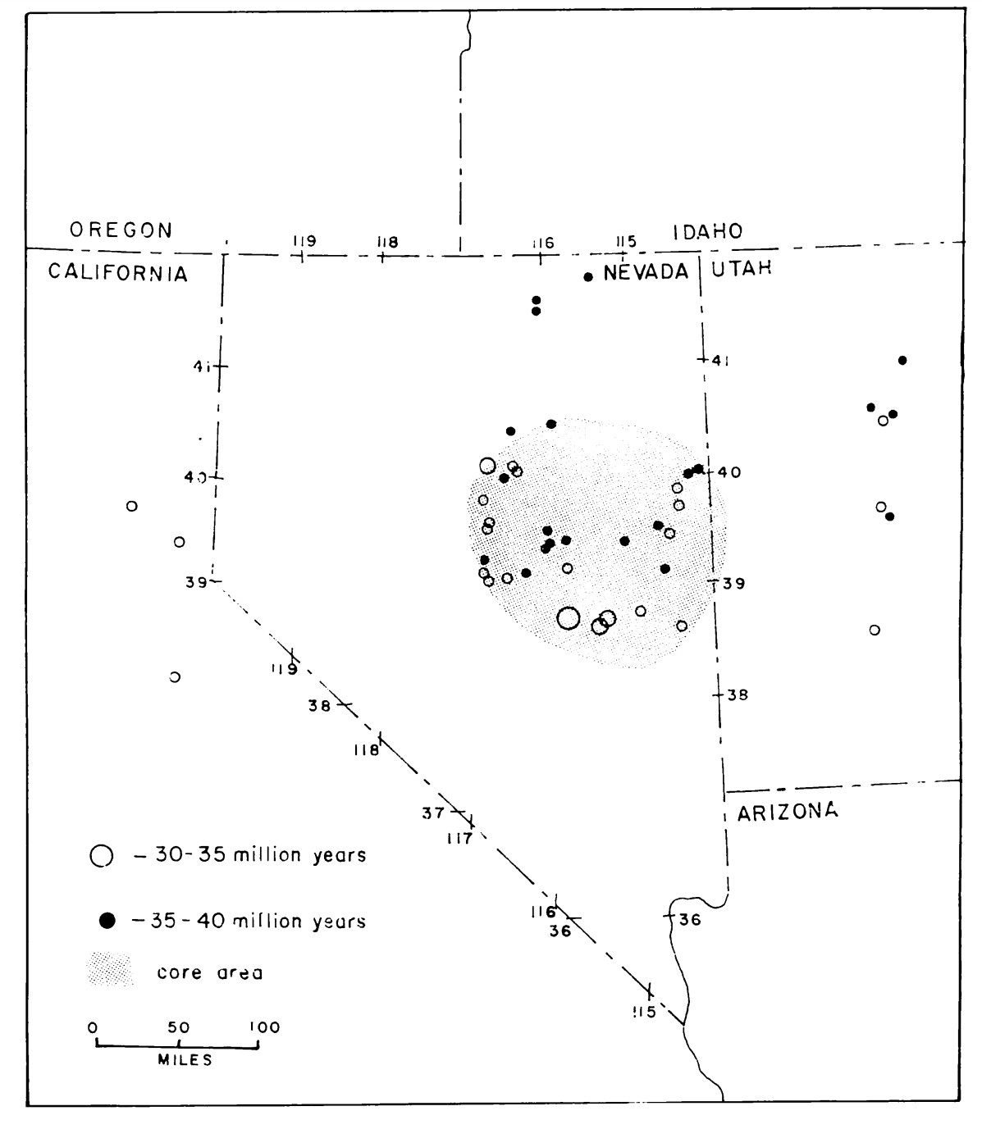
30-40Ma 30-20Ma 20-10 Ma 10 - 5 Ma .

Slide 11
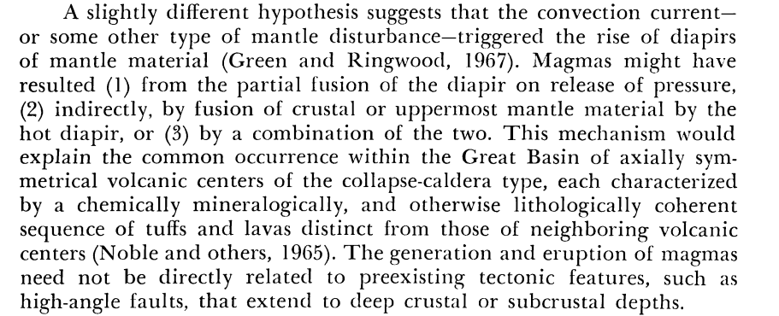

Slide 12
